Slide 1
New Mexico Environment Department
Quality Assurance in Southern Doña Ana County
Ryan Maxfield, ESS-A QA Auditor
February 17, 2023

Slide 2
Quality System Framework
Guidance Documents for Quality System Implementation in Accordance with NAAQS Standards in a SLAMS Network
40 CFR Documents (Parts 50, 53 & 58)
QA Handbook Volume II
Quality Assurance Project Plan (QAPP)
EPA’s Technical Assistance Documents
Standard Operating Procedures
Documentation and Reports

Slide 3
Site Selection
Monitor Designation
Pollutants Monitored
Siting Criteria
Distances
Probe Placement
Air Flow Considerations

Slide 4
Monitoring Equipment Operation
PM₁₀
PM_{2.5}
Ozone (O₃)
Nitrogen Dioxide (NO₂)
Preventive maintenance
Metadata with respect to operating conditions
Quality control
Flow, temperature and pressure
Leak checks
1-point QC Checks

Slide 5
Data Validation
Field Activities
Administrative Activities
Monthly/quarterly manual calibration
Weekly automated 1-pt QC checks
Semiannual/annual QA audit
Tri-annual NPAP audit
Network review
Instrument performance evaluation
Data Quality Assessment
Technical Systems Audit

Slide 6
Southern Doña Ana County Sites
https://aqicn.org/map/newmexico/

Slide 7
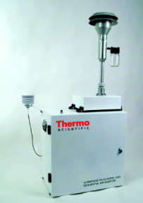
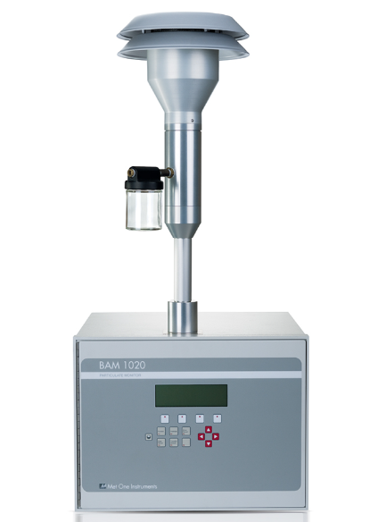
Particulate Monitoring Equipment
Federal Reference Method
Federal Equivalent Method
Filter-Based
Non-continuous
Filters require pre and post weighing
Beta Attenuation
Continuous
Real-time data
Low maintenance

Slide 8
Filter Weight Issues
Filter blank discrepancies
Receipt of damaged filters
Filter weights not obtained within specification
Lab temp/humidity out of conformance
Lab not following SOP

Slide 9
Background Ozone Characteristics
Wind blowing from the west at 10 to 15 m/s
Wind blowing from the southeast at 8 to 10 m/s
6ZN Santa Teresa Ozone
Note: Graphics utilize non-validated data
6ZM Desert View
Note: Graphics utilize non-validated data

Slide 10
Contact Information
Email: ryan.maxfield@env.nm.gov
Phone: (915) 262-8793
https://www.env.nm.gov/
Questions?

